Slide 1

Software Development Project CS104 Robotics Triathlon
by: Luca Bertinelli, Xochitl Martinez, & Delvis Rodriguez

Slide 2
What was the purpose of this project?
The purpose of this project was to test our group and individual ability to problem solve, quantify, organize, document, code test, and present a software system.
This is called ‘software engineering’.
Did we face any challenges?
Yes. As a group we faced many challenges.
#1. Managing our schedules to meet up and work on it together.
#2. Finding the degree of the angle for our robot to turn to.
#3. Robot inaccuracies with the block code.

Slide 3
What were each of our roles?
Delvis:
Block code
Luca:
Flowchart maker
Xochitl:
System Design Document
Sensor Data Diagram
System Design Document
Test plan
Functional Requirements
Gantt Chart organizer
Track taper
Algorithm maker
Functional Requirements
Test Plan
Video Recording
Staffing Plan
Requirement sign-off table
Agility Design Document
System Design Document

Slide 4
What have you learned about Software Engineering?
What we learned about Software Engineering throughout the course of this project is how crucial communication is to the entire process as well as how important.
What would we have done differently?
What we would have done differently in this project is to get rid of any distractions that may have delayed our testing.

Slide 5
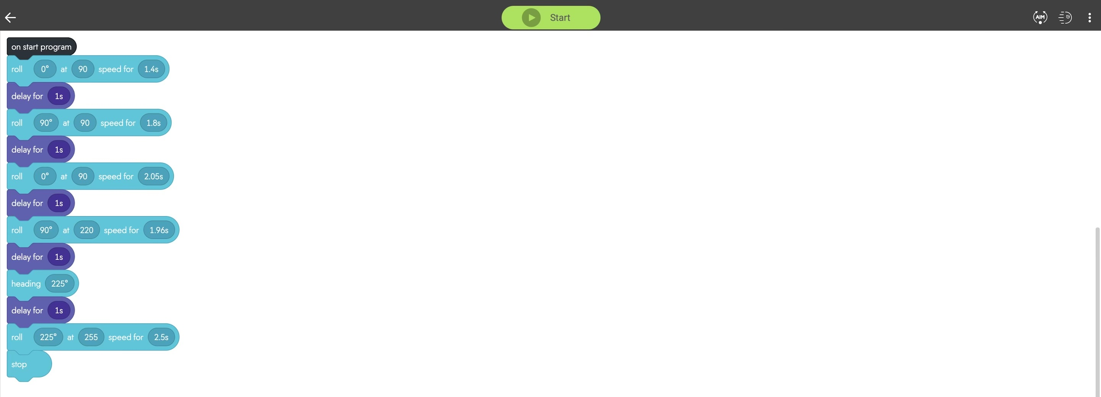
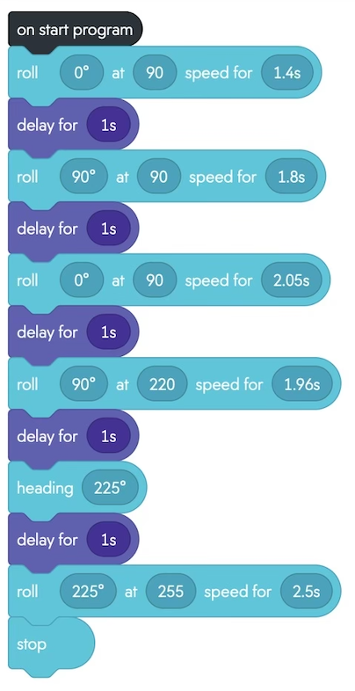
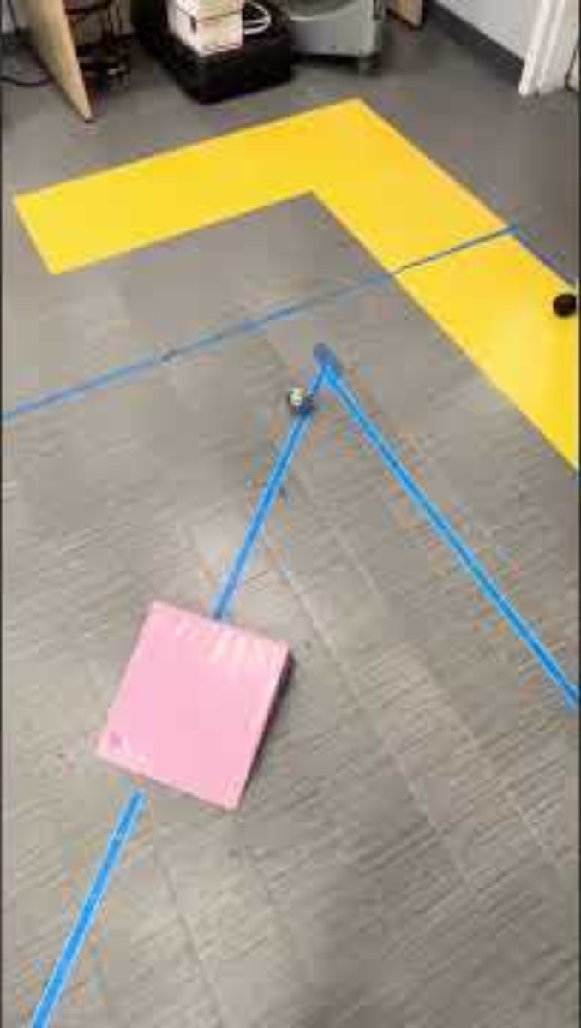
Link to view our video:
CS104 Sprint 4-Agility video
✨
✨

Slide 6
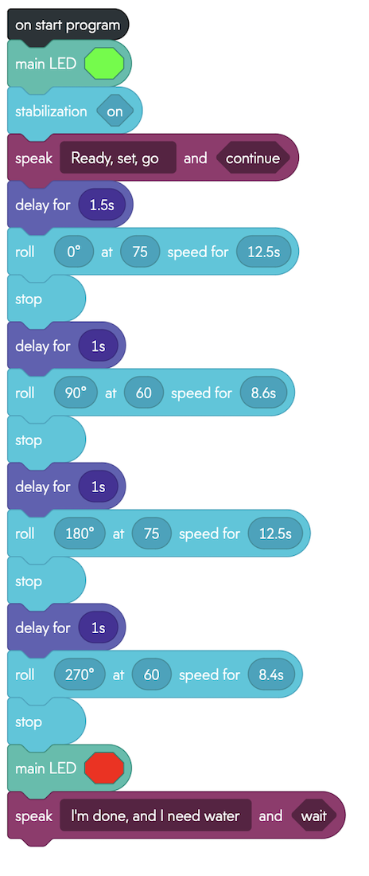
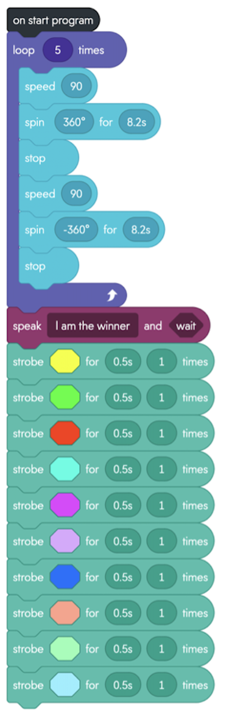
Links to view our Endurance and Accuracy video:
CS104 Sprint 1–Endurance video
CS104 Sprint 2–Accuracy video

